Slide 1
Depth-First Search performance in random digraphs
Philippe Jacquet (Inria, France) Svante Janson (Uppsala, Sweden)
AofA2024, Bath, UK
June 21, 2024

Slide 2
Random walk and deep search in (di)graphs
Google search “who built Stonehenge”
Most popular pages
Least popular pages

Slide 3
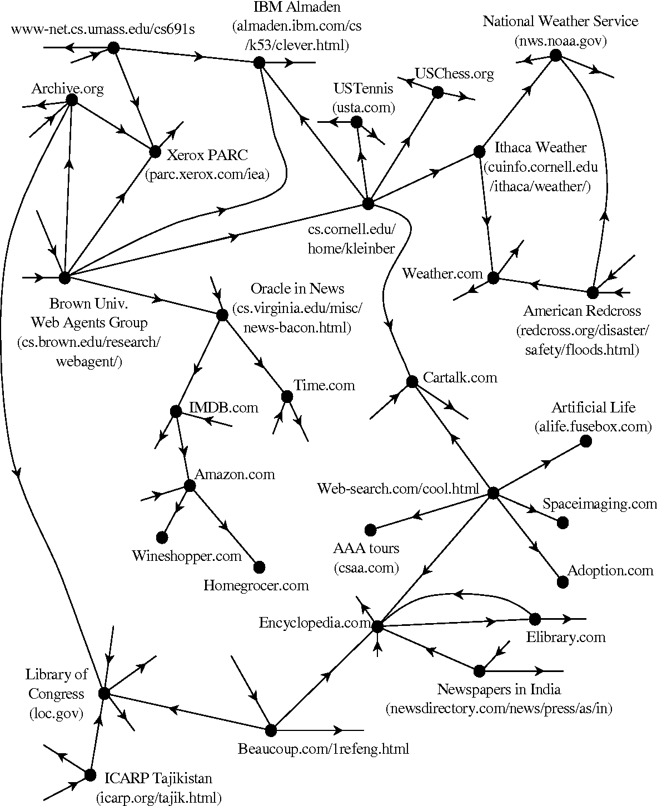
Vertex Popularity in graphs
Popularity=Stationary weights in graph crawling
Google web crawling (several in parallel, every day)
Random walk $⇔$ Deep First Search

Slide 4
Model of random digraph
Undirected graph over n vertices
Every vertex randomly selects $η$ outgoing neighbor arcs
The degrees $η$ are i.i.d random variables: $G_{η}(z)=\sum_{k}{P\left(η=k\right)z^{k}}$with a finite variance.
A vertex can loop on itself
Two arcs may have same end vertices.
When $λ=E\left[η\right]>1$ the DFS starts on a supercritical tree. Our hypothesis

Slide 5
Some selected references
Tarjan the inventor of DFS
Donald E. Knuth, the AoCP vol 4C exercise about the exponential degree
Laurent Ménard Nathan Noiry Nathanaël Enriquez, Gabriel Faraud. Depth first exploration of a configuration model. Electron. J. Probab., (53), 2022. DFS on undirected graph
PJ, SJ. Depth-First Search performance in a random digraph with geometric outdegree distribution. La Matematica (2024).

Slide 6
The Deep First Search in a glance
Giant tree
Ascending
phase
Descending
phase
# discovered vertices
0
$$T_{0}=\left(1−\frac{1}{λ}\right)n$$
$$T_{1}$$
n

Slide 7
DFS pseudocode
Procedure DFS()
NotVisited$←$VertexSet
While NotVisited$≠∅$ do
u $←$ TakeFirst(NotVisited)
Deep(u)
Procedure Deep(u)
For each v$∈𝒩(u)$ do
If v$∈$NotVisited then
Remove(v,NotVisited)
Deep(v)
Linear implementation:
The whole neighborhood is stored

Slide 8
Linear code: Stack index
I(t) stack size when t vertices have been discovered.
Theorem 1: when n tends to infinity with high probability $I\left(t\right)=n{\left[i\left(t/n\right)\right]}^{+}+O(n^{\frac{1}{2}})$ with $i\left(θ\right)=λθ+log⁡(1−θ)$.

Slide 9
Proof of theorem 1 (easy)
Proof: the stack is a list of arcs. I(t) is a non homogeneous random walk over the arcs. When t vertices have been discovered, to find the next vertex one has to
1. to update the stack $I\left(t\right)+η_{t}−1$
2. To remove from the stack all the arcs toward already visited vertices
Where $ξ(p)≡geo(p)$, because
Thus $\frac{∂}{∂t}E\left[I\left(t\right)\right]=λ−\frac{1}{1−\frac{t}{n}}$ when $I\left(t\right)=O(n)$.
Remark $θ_{1}=\frac{T_{1}}{n}=1+\frac{1}{λ}W(−\frac{e^{−λ}}{λ})$
$$I\left(t+1\right)={\left[I\left(t\right)+η_{t}−1−ξ\left(\frac{t}{n}\right)\right]}^{+}$$

Slide 10
DFS pseudocode
Procedure DFS()
NotVisited$←$VertexSet
While NotVisited$≠∅$ do
u $←$ TakeFirst(NotVisited)
Deep(u)
Procedure Deep(u)
For each v$∈𝒩(u)$ do
If v$∈$NotVisited then
Remove(v,NotVisited)
Deep(v)
Recursive implementation:
a single neighbor is stored

Slide 11
Recursive code: search depth
d(t) is the search depth when t vertices have been discovered
Theorem 2: when n tends to infinity with high probability $d\left(t\right)=nℓ\left(\frac{t}{n}\right)+O\left(n^{1−ε}\right)$ with
$ℓ\left(θ\right)=\int_{0}^{θ}{ρ\left(x\right)dx}$when $0<θ<θ_{0}$
$ℓ\left(θ\right)=ℓ(\breve{θ})$ when $θ_{0}<θ<θ_{1}$ where $\breve{θ}$ is a “mirror” function $\frac{d\breve{θ}}{dθ}=\frac{\frac{1}{1−θ}−λ}{\frac{1}{1−\breve{θ}}−λ}$
$ℓ\left(θ\right)=0$ when $θ>θ_{1}$

Slide 12
The mirror function
Depends only on the average outdegree
$$\breve{θ}=1+\frac{1}{λ}W\left(\left(θ−1\right)e^{\left(θ−1\right)λ}\right)$$
Mirror function for $λ=2$
$$θ$$
$$θ_{0}$$
$$\breve{θ}$$

Slide 13
The BGW survivability probability
Quantity $ρ(θ)$ is the survivability probability in a BGW tree with random outdegree $η$ and extinction rate $θ$.
The non trivial solution of $1−ρ\left(θ\right)=G_{η}\left(1−\left(1−θ\right)ρ\left(θ\right)\right)$
The function $ℓ\left(θ\right)=\int_{0}^{θ}{ρ\left(x\right)dx}$ has no universal simple expression contrary to $i(θ)$.

Slide 14
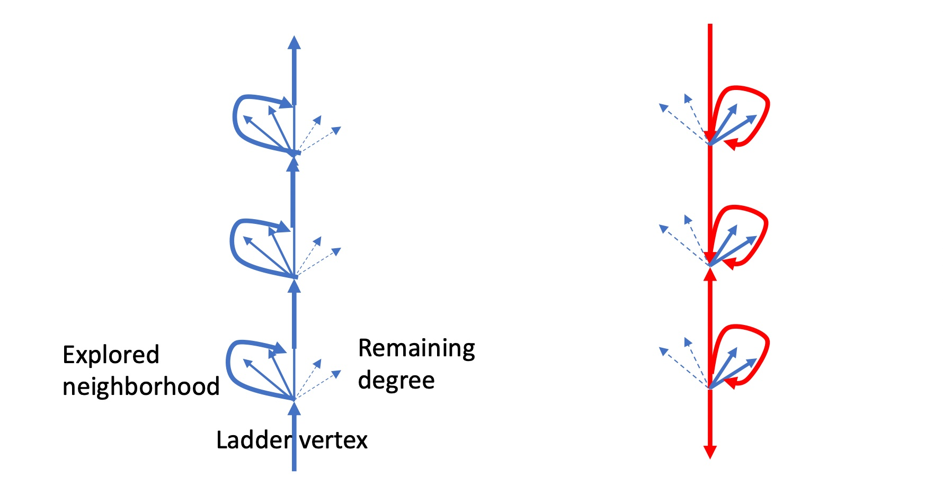
Proof of theorem 2 (not easy)
The ascending phase goes through ladder vertices
The descending goes through the same ladder vertices
Ascending phase
Descending phase

Slide 15
Proof of theorem 2 (hard)
On the ascending phase $d→d+1$between two ladder vertices: average number of visited vertices
$$\frac{1}{ρ(θ)}$$

Slide 16
Proof of theorem 2 (harder)
On the descending phase: the p.g.f of the remaining degree (for $θ_{0}<θ<θ_{1}$) is
The p.g.f. of number of vertices to be visited before dropping to the lower ladder point is
With $g_{θ}\left(z\right)=zG\left(θ+\left(1−θ\right)g_θ(z)\right)$
With average
$$\tilde{η}\left(z\right)=(1−\breve{θ})\frac{G_{η}\left(z\right)−1+ρ(\breve{θ})}{z−1+(1−\breve{θ})ρ(\breve{θ})}$$
$${\overline{H}}_{θ}\left(z\right)=(1−\breve{θ})\frac{\frac{g_{\breve{θ}}(z)}{z}−1+ρ(\breve{θ})}{\left(1−θ\right)g_{θ}\left(z\right)+(1−\breve{θ})ρ(\breve{θ})}$$
$${\overline{H}}_{θ}^{′}\left(1\right)=\frac{1}{ρ(\breve{θ})}\frac{λ−\frac{1}{1−\breve{θ}}}{\frac{1}{1−θ}−λ}$$

Slide 17
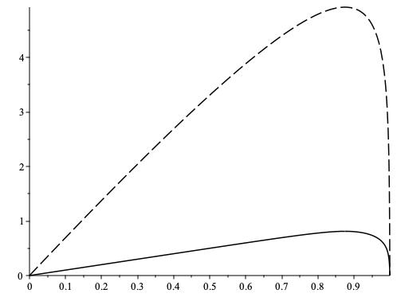
Numerical applications
$$i(θ)$$
$$ℓ(θ)$$
$$θ$$
$$θ$$
$$η=2$$
$$η=8$$

Slide 18
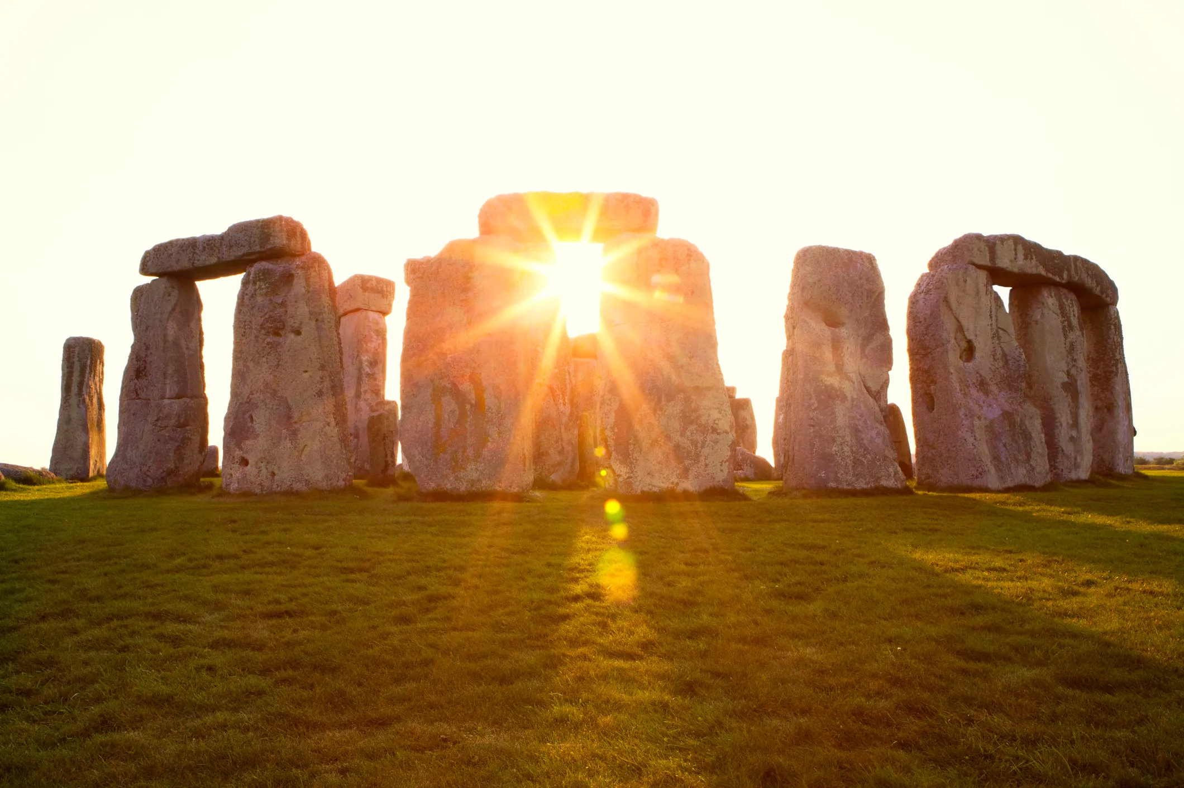
Thank you!

