Slide 1
Periodic behavior of the minimal Colijn-Plazzotta rank for trees with a fixed number of leaves
Michael Doboli, Hsien-Kuei Hwang, Noah A. Rosenberg

Slide 2
Background
Asymptotic expansion
Lower Bound on Exponential Order
Upper Bound on Exponential Order
Mean Exponential Order
Conclusion

Slide 3
Unlabeled Rooted Binary Trees
The unlabeled binary rooted trees are rooted trees such that each internal node has exactly two immediate descendants.
We consider only unordered trees (non-plane).
The number of unlabeled rooted binary trees on $n$leaves is enumerated by the Wedderburn-Etherington numbers, 1, 1, 1, 2, 3, 6, 11, 23, 46, 98... (OEIS A001190).

Slide 4
Colijn-Plazzotta (CP) Bijection
Colijn & Plazzotta (2018, Systematic Biology 67:113-126) devise a bijection between the unlabeled rooted binary trees and the positive integers.
If $T$ is the set of all unlabeled rooted binary trees, then the CP bijection is a function $f:T→{\text{ℤ}}^{+}$ that satisfies:
(a) $f\left(t\right)=1$ if $t$ has one leaf.
(b) Otherwise, let $ℓ(t)$ be the left subtree of $t$ and $r(t)$ be the right subtree of $t$ such that $f(ℓ\left(t\right))≥f\left(r\left(t\right)\right).$ Then
$f\left(t\right)=\frac{f\left(ℓ\left(t\right)\right)\left[f\left(ℓ\left(t\right)\right)−1\right]}{2}+1+f(r\left(t\right))$.

Slide 5
CP Bijection Example
$$13$$
$$f\left(t\right)=\frac{f\left(ℓ\left(t\right)\right)\left[f\left(ℓ\left(t\right)\right)−1\right]}{2}+1+f(r\left(t\right))$$
$$5$$
$$2$$
$$3$$
2
$$1$$
$$1$$
$$1$$
$$1$$
$$1$$
$$1$$

Slide 6
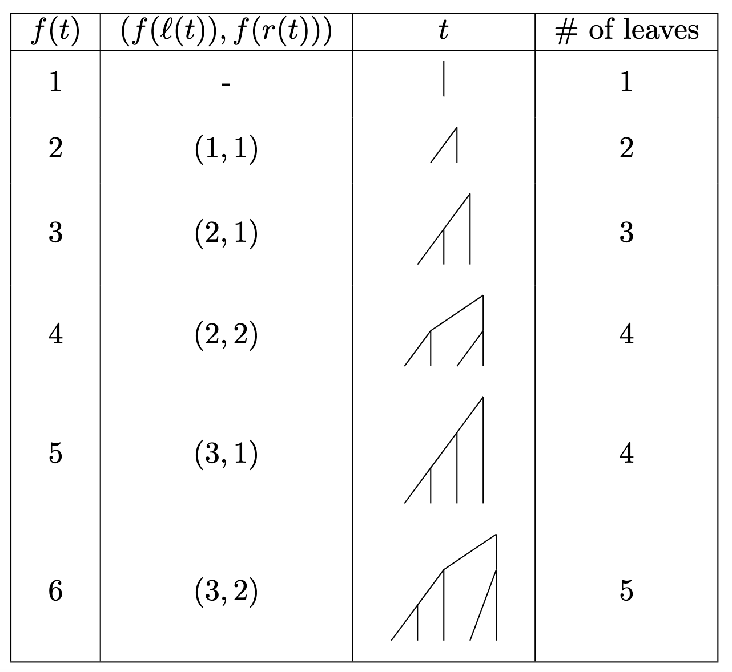
CP Bijection Motivation

Slide 7
CP Rank
The rank of a tree $t$ is defined as $f\left(t\right)$: the positive integer that the tree maps to under the CP bijection.
Rosenberg (2021, Discrete Applied Mathematics 291: 88-98) finds the minimal and maximal CP rank on $n$ leaves in the bifurcating case ($k$ = 2).

Slide 8
Minimal & Maximal CP rank for $k=2$
If $a_{n}$ denotes the minimal CP rank on $n$ leaves and $b_{n}$denotes maximal CP rank on $n$ leaves, then

Slide 9
Minimal & Maximal CP rank for $k=2$
The first few values of $a_{n}$ are $1, 2, 3, 4, 6, 7, 10, 11, 20, 22, 28, 29, 53, 56, 66, 67, 202, 211, 252, 254, 401, 407,…$ (OEIS A354970).
The first few values of $b_{n}$ are $1, 2, 3, 5, 12, 68, 2280, 2598062, …$ (OEIS A108225).

Slide 10
Asymptotics of $a_{n}$ and $b_{n}$ for $k=2$
Rosenberg 2021 finds an exact asymptotic formula for $b_{n}:$
and an upper bound for $a_{n}:$
Is a more refined asymptotic analysis of $a_{n}$ possible? This question was posed at least year’s AoA!

Slide 11
Background
Asymptotic expansion
Lower Bound on Exponential Order
Upper Bound on Exponential Order
Mean Exponential Order
Conclusion

Slide 12
Divide-and-conquer recurrences
The recurrence for $a_{n}$ resembles the more general divide-and-conquer recurrences. These recurrences are of the form

Slide 13
$a_{n}$ as a divide-and-conquer recurrence
We write $a_{n}$ as an explicit divide-and-conquer recurrence:
If we let $a_{n}=2g_{n}−\frac{1}{2}$ and $h_{n}=g_{⌊n/2⌋}−g_{\left\lceil n/2\right\rceil }+\frac{11}{16}$ for $n≥2$:

Slide 14
Writing $a_{n}$ as a divide-and-conquer recurrence
If we let $λ_{n}=\log_{2}{g_{n}}$ and $μ_{n}=\log_{2}{(1+\frac{h_{n}}{g_{\left\lceil \frac{n}{2}\right\rceil }^{2}}) }$then
which is precisely the form the we want.

Slide 15
Applying Hwang et al. 2017
The relevant result is the following: suppose $f\left(n\right)=2f_{⌈n/2⌉}+g_{n}$ for $n≥2$, where $f\left(1\right)$ is given and $g\left(1\right)=0$.
Suppose further that the function $G_{m}\left(t\right)=\sum_{k=0 }^{m}{2^{−k}g(\left\lceil 2^{k}t\right\rceil )}$ converges uniformly to $G\left(t\right)=\sum_{k=0}^{∞}{2^{−k}g(\left\lceil 2^{k}t\right\rceil )}$ for $t∈[1,2]$
Then for $n≥1$ we have that $f\left(n\right)=nP(\log_{2}{n)−Q(n)},$ with $P$ and $Q$ defined by

Slide 16
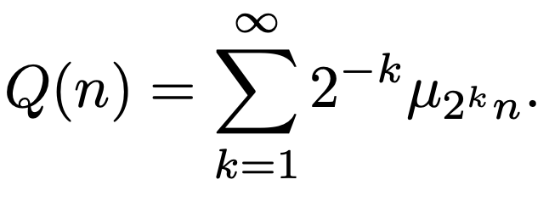
Applying Hwang et al. 2017
Since $μ_{n}$ is O(1), we can use the Weierstrass M-test to show that the required uniform convergence condition holds.
Applying this result to our context yields that $λ_{n}=nP\left(\log_{2}n\right)−Q\left(n\right),$ where
and

Slide 17
Closed formula for $a_{n}$
Unpacking our definition of $g_{n}$ yields
Since $Q\left(n\right)→0$, we deduce that $a_{n}∼{2\left(2^{P(\log_{2}{n})}\right)}^{n}$, or more precisely $\lim_{n→∞ }{\frac{a_{n}}{{2\left(2^{P(\log_{2}{n})}\right)}^{n}}=1.}$

Slide 18
Asymptotics of $a_{n}$
Since $P$ is 1-periodic, to gather more precise information about the exponential growth of $a_{n}$ it suffices to study the extrema of $2^{P(t)}$ on $t∈[0,1]$.

Slide 19
Plotting an approximation of $2^{P(t)}$
To get a better sense of the problem we can plot an approximation to $2^{P(t)}.$
We do this by approximating
by its first 10 terms for $t=\frac{k}{100000}$ for all integers $0≤k<100000$.

Slide 20
Plot of an approximation of $2^{P(t)}$

Slide 21
Background
Asymptotic expansion
Lower Bound on Exponential Order
Upper Bound on Exponential Order
Mean Exponential Order
Conclusion

Slide 22
Lower Bound on Exponential Order
The graph suggests that the lower bound occurs when $t=0$. That is, we claim that , or equivalently that . .
Plugging $t=0$ into the formula for $P(t)$ yields
We can rewrite this inequality as

Slide 23
Plan of Attack
We would like to separate this sum into “small $k”$ and “large $k$”.
The “small $k”$ will be handled computationally as it turns into a sum with a finite number of cases to check.
The “large $k$” will be handled by an upper bound on $|μ_{x}|$ that kicks in for sufficiently large $x$.

Slide 24
Essential Lemmas
To prove the inequality
we show two separate parts:
Lemma 1: For integers $k≥11$ and all $t∈(0,1)$
Lemma 2: For all $t∈(0,1)$

Slide 25
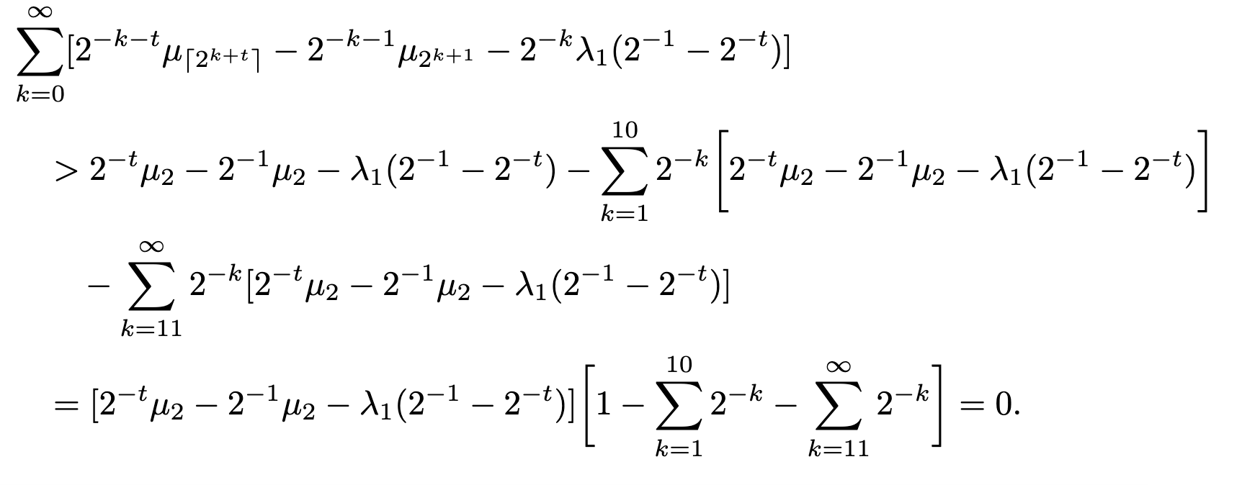
Essential Lemmas prove inequality
Assuming Lemmas 1 & 2 hold, we will have that

Slide 26
Proof of Lemma 1
Lemma 1: For integers $k≥11$ and all $t∈(0,1)$
Proof (outline):
Rearranging all the $t$ terms to one side yields
The left-hand side strictly decreases with $t$ unless there is a discontinuity, which is when $2^{k+t}$ is an integer.

Slide 27
Proof of Lemma 1
Hence it suffices to check
when $2^{k+t}$ is an integer or $t→1^{−}$.
The inequality is trivial as $t→1^{−}$.
If $2^{k+t}$ is an integer, write $t=\log_{2}\left(2^{k}+n\right)−k$ for some integer $n$. This yields the inequality

Slide 28
Proof of Lemma 1
Instead of
we can in fact prove the stronger inequality
or equivalently

Slide 29
Proof of Lemma 1
Utilizing this lemma
We can prove the following upper bound on ${|μ}_{x}$| :
Lemma 3: For all integers $x≥267$,

Slide 30
Proof of Lemma 2
Lemma 2: For all $t∈(0,1)$
Once again moving all the $t$ terms to one side
Like before, the left-hand side strictly decreases with $t$ except at discontinuities, so it suffices to check this for when $2^{k+t}$ is an integer or $t→1^{−}$.
Also like before, the inequality is trivial for $t→1^{−}.$

Slide 31
Proof of Lemma 2
However, since $k∈\{1, 2, …, 10\}$, there are only finitely many discontinuities to check.
This means that we can numerically verify this inequality for all the finitely many discontinuities.

Slide 32
Background
Asymptotic expansion
Lower Bound on Exponential Order
Upper Bound on Exponential Order
Mean Exponential Order
Conclusion

Slide 33
Plot of an approximation of $2^{P(t)}$

Slide 34
Upper Bound on Exponential Order
The plot of $2^{P(t)}$ suggests that Like before, to
show this we show that .
The corresponding inequality we wish to show is for all $t∈(0,1)$
or equivalently

Slide 35
Lemmas 4 & 5
We do a very similar strategy as the lower bound. In particular, we show the following two lemmas:
Lemma 4: For all integers $k≥11$ and $t∈(0,1)$
Lemma 5: For all $t∈(0,1)$

Slide 36
Lemmas 4 & 5 imply inequality
Assuming lemmas 4 & 5 hold, then we will have that

Slide 37
Lemmas 4 & 5 imply inequality
The proofs of Lemmas 4 & 5 follow the same methods as Lemmas 1 & 2.
This shows that the supremum of $2^{P(t)}$ is $\lim_{t→0^{+}}2^{P(t)}.$

Slide 38
Background
Asymptotic expansion
Lower Bound on Exponential Order
Upper Bound on Exponential Order
Mean Exponential Order
Conclusion

Slide 39
Mean Exponential Order
Adapting the methods from Hwang et al. 2017 allows us to compute $𝔼[P\left(t\right)]$.
Since $P$ is 1-periodic, we assume that $0≤t<1$. Since $P\left(t\right)$is bounded and continuous almost everywhere, the integral $𝔼\left[P\left(t\right)\right]$ is well-defined. Moreover, doing a Dominated Convergence Theorem argument to swap integrals and sums yields

Slide 40
Bounding the mean Exponential Order
By Jensen’s inequality applied to the convex $φ\left(x\right)=2^{x}$
Hence, the mean value of $2^{P(t)}$ is at least $1.286$.
Since $\{\log_{2}{n\}_{n∈ℤ} }$is not equidistributed, this computation gives us only an approximation of $2^{P(\log_{2}{n)}}$.

Slide 41
Background
Asymptotic expansion
Lower Bound on Exponential Order
Upper Bound on Exponential Order
Mean Exponential Order
Conclusion

Slide 42
Conclusion
We find that the formula
has asymptotic expansion
where

Slide 43
Conclusion
Moreover the 1-periodic function $P(t)$ has its minimum at $t=0$ and its supremum as $t→0^{−}$.
That is, we deduce that
where

Slide 44
Conclusion
Recalling that and using the fact that
$Q\left(n\right)>0$ for all $n≥1$ implies that for all positive integers $n$
where $c_{2}≈1.33429$. This improves upon Rosenberg 2021’s upper bound $a_{n}<{\left(\frac{3}{2}\right)}^{n}$and is the best possible exponential upper bound that holds for all $n≥1$.
Moreover, our work agrees with Rosenberg 2021’s result that $a_{2^{n}}∼2α^{(2^{n})}$, where his constant $α$ coincides with our constant $c_{1}$.

Slide 45
Conclusion
Recalling that the asymptotic formula for the maximal rank was $b_{n}∼2β^{(2^{n})}$ for a constant $β≈1.05653$, this verifies the intuition that the maximal CP rank grows much quicker than the minimal CP rank.
This work also solves a previously open problem in Fischer et al. 2023, which asks if a precise asymptotic formula for $a_{n}$ can be found.

Slide 46
Acknowledgements
We thank Daniel Krenn and Stephan Wagner for their helpful conversations at least year’s AoA.
We also thank the members of the Rosenberg lab for their help; in particular Egor Lappo, Chloe Schiff, and Lily Agranat-Tamir.

Slide 47
References
C. Colijn and G. Plazzotta. A metric on phylogenetic tree shapes. Syst. Biol., 67:113–126, 2017.
H.K. Hwang, S. Janson, and T.H. Tsai. Exact and asymptotic solutions of a divide-and-conquer recurrence dividing at half: theory and applications. ACM Trans. Alg., 13:47, 2017.
N. A. Rosenberg. On the Colijn-Plazzotta numbering scheme for unlabeled binary rooted trees. Discr. Appl. Math., 291:88–98, 2021.

Slide 48
Thank you!

